Slide 1
UMAP
Uniform Manifold Approximation and Projection
= DIMENSION REDUCTION

Slide 2
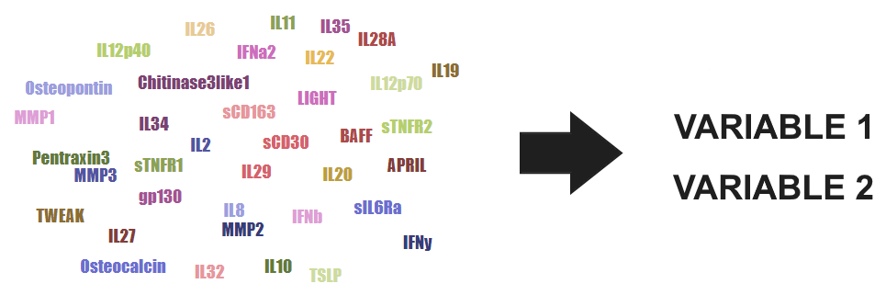
What is dimension reduction?

Slide 3
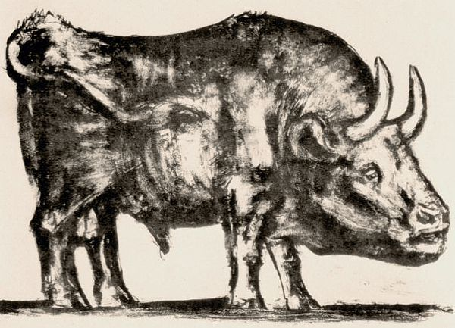
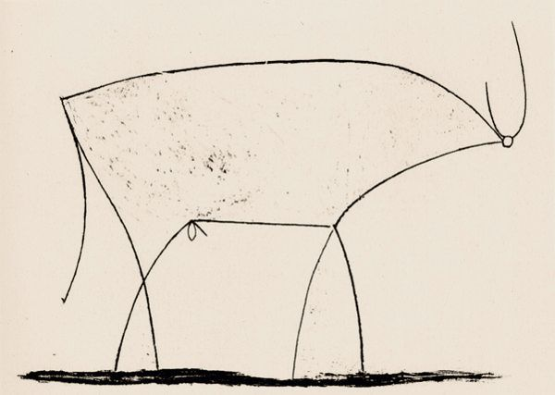
Picasso’s Bull (1945)

Slide 4
Two types of dimension reduction
Global structure
Local structure
PCA
LargeVis
MDS
?
t-SNE
Sammon
mapping
Isomap
Laplacian
eigenmaps

Slide 5
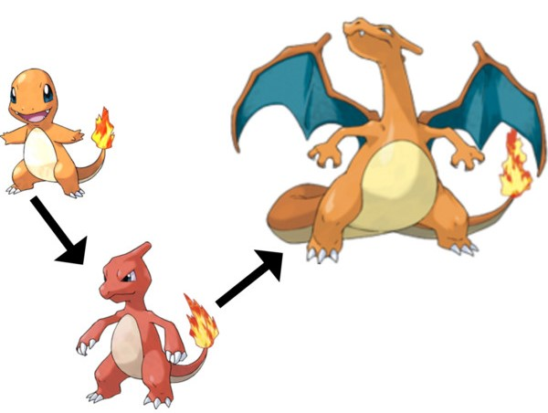
(simplified) evolution of dimension reduction
PCA (1901)
UMAP (2018)
t-SNE (2008)

Slide 6

Handwritten numbers (MNIST)

Slide 7
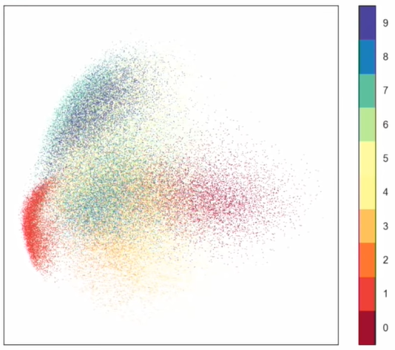
PCA on MNIST

Slide 8
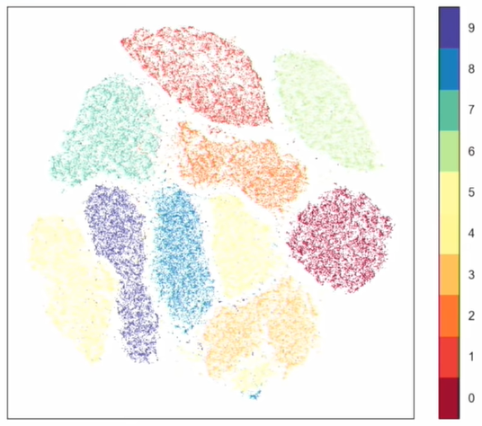
t-SNE on MNIST

Slide 9
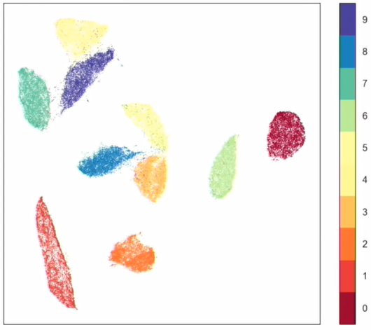
UMAP on MNIST

Slide 10
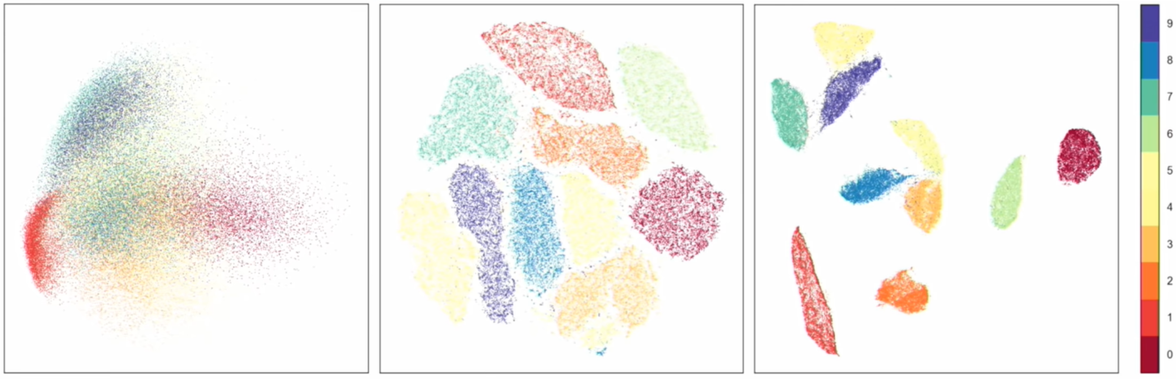
PCA
t-SNE
UMAP
4
1
6
9
9
7
7
2
5
0
8
9
0
3
6
0
8
5
1
4
3
1
2
Notice 4, 7, 9 and 3, 5, 8 + similarities between PCA and UMAP.

Slide 11
How UMAP differs from t-SNE
UMAP shows global structure
Faster, like 10 times faster
Less random
Many metrics (at least 21)
Supports supervision and semi-supervision
Grounded in solid math (algebraic topology)

Slide 12
Math in UMAP
Construct a fuzzy high-dimensional graph of the data
Represent this graph in lower dimensions
https://pair-code.github.io/understanding-umap/

Slide 13
Three parameters (+ more)
Parameter Sensible range A reasonable default # of neighbors 5 to 50 15
min distance 0.001 to 0.5 0.1
Metric anything Euclidean?

Slide 14
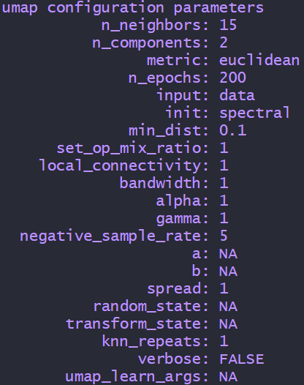

Slide 15
Keep these in mind with UMAP
Parameters matter
Axes might be meaningless
Even noise has structure
There is a random element

Slide 16
Dissecting the NK cell population in hematological cancers confirms the presence of tumor cells and their impact on NK population homeostasis
A.
all sample
HD
diagnosis
treatment
UMAP-Y
UMAP-X

Slide 17


Slide 18
Useful links
https://umap-learn.readthedocs.io/ (excellent documentation)
https://arxiv.org/abs/1802.03426 (original UMAP paper)
https://github.com/lmcinnes/umap (git repository for UMAP)
https://www.youtube.com/watch?v=nq6iPZVUxZU (30 min introduction)
https://pair-code.github.io/understanding-umap/ (UMAP interactive)
https://towardsdatascience.com/how-exactly-umap-works-13e3040e1668 (in-depth comparison of UMAP and t-SNE)
http://yann.lecun.com/exdb/mnist/ (MNIST dataset of numbers)

Slide 19
Sources for pics and video
http://ffden-2.phys.uaf.edu/webproj/212_spring_2017/Andrew_Adler/Physics_of_Pokemon/evolution.html (pokemon pic)
https://www.youtube.com/watch?v=nq6iPZVUxZU (MNIST plots)
https://towardsdatascience.com/how-exactly-umap-works-13e3040e1668 (motorcycle pic)
https://www.youtube.com/watch?v=nCk8dyU7zUM (primes video)

Slide 20
